Slide 1
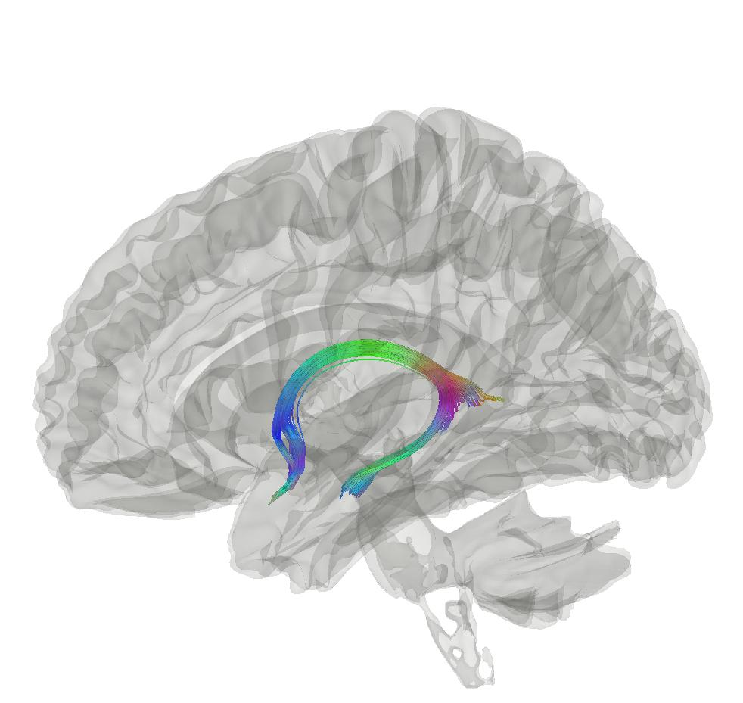



Disease and Ageing Biomarker Identification from multimodal magnetic resonance imaging
Max Korbmacher
Western Norway University of Applied Sciences, Bergen
Email: Max.Korbmacher@hvl.no
Twitter: @KorbmacherMax

Slide 2
What I will talk about today
Concepts
Results
Conclusions
PART I: CONCEPTS
A short note on biomarkers & overview
PART II: RESULTS
White matter ageing
Putting brain age to the test
Brain asymmetries & hemispheric brain age
PART III: CONCLUSIONS

Slide 3
1. CONCEPTS

Slide 4
1. Ageing and diffusion MRI
Concepts
Results
Conclusions
Key concepts, which I assume you are familiar with:
Brain ageing and brain age
Diffusion MRI (biophysical models)

Slide 5
2. Biomarkers
Concepts
Results
Conclusions
Although in the title, the definition of biomarkers is a little challenging
Biomarkers can generally be understood in the context of the field of application such as patient care, therapeutics, and (clinical) research

Slide 6
2. Biomarkers
Concepts
Results
Conclusions
Or applied to the brain:
Biomarkers are reliable indicators of both biological and mental processes, treatment or intervention responses, and/or behavioural indices

Slide 7
3. Putting it all together
Concepts
Results
Conclusions
Diffusion MRI
Voxel to whole brain associations
T1w MRI
Biomarkers
(or rather markers of ageing?)
QC & technical parameters
Brain age
Bio-psycho-social phenotypes
PGRS
Data: UKB, TOP, NCNG, BBSC, FTHP

Slide 8
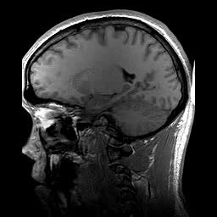
1. Brain ageing and brain age
Concepts
Results
Conclusions
Brain age gap (BAG) calculation
Train a model from MR data
Do age predicitons for each individual: “Your brain is X years old”
BAG = difference between chronological and predicted age
BAG associations
Related with a whole bunch of phenotypes, clinical symptoms and diagnoses¹
Larger in several clinical groups vs controls¹
Chronologically 22 years old
Age prediction
Biologically 28 years old
BAG = 6 years
1 Franke & Gaser, 2019, Front. Neurol., 789

Slide 9
1. Brain ageing and brain age
Concepts
Results
Conclusions
What’s the takeaway from normative ageing?
We can use age-associations to learn about healthy and non-healthy ageing
Brain age is a (simple) proxy of this (complex) process

Slide 10
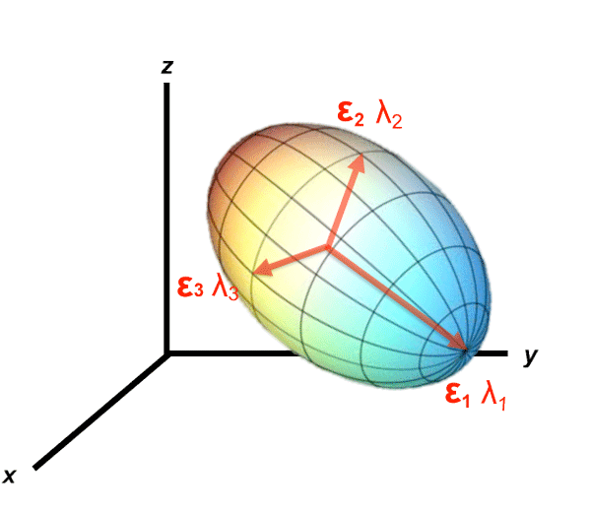
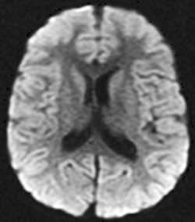
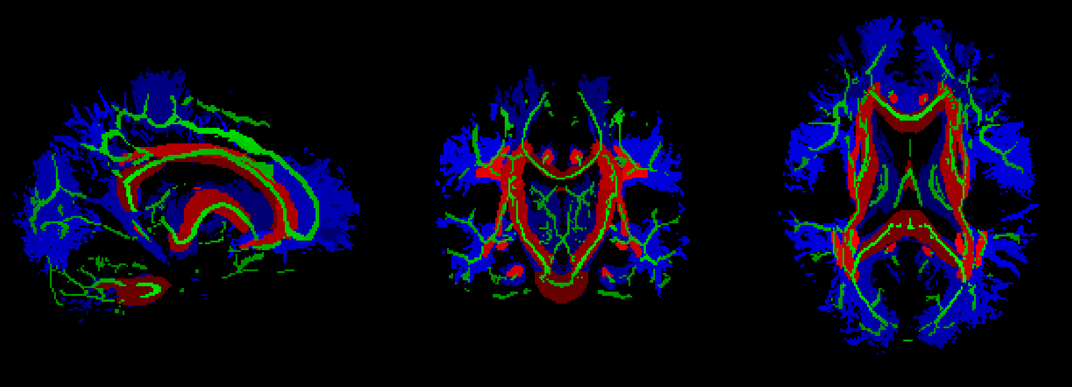
Concepts
Results
Conclusions
2. Diffusion MRI (biophy. models)
Biophysical modelling of diffusion: from signal representation to tissue models
A
B
C

Slide 11
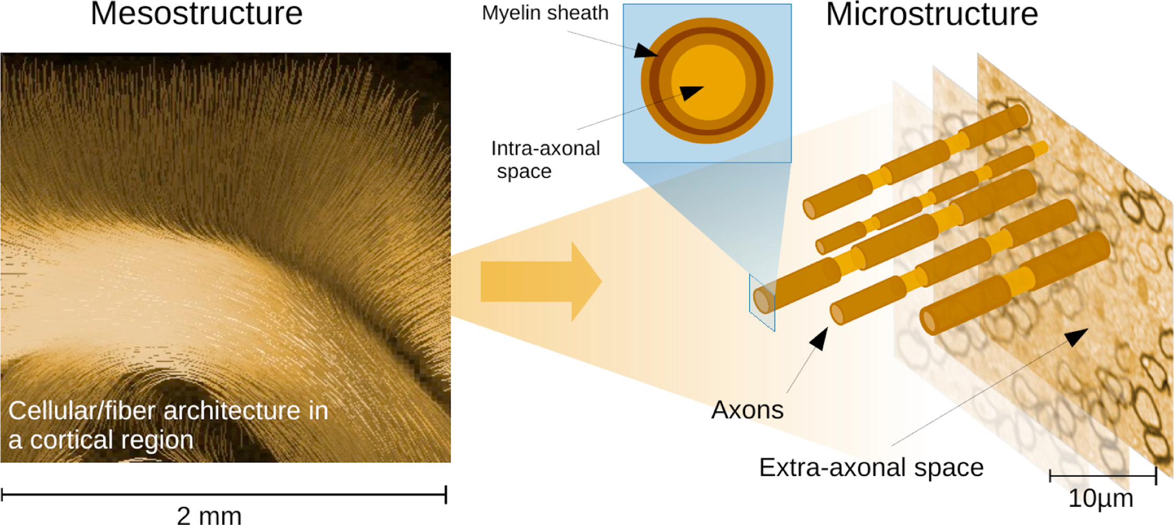
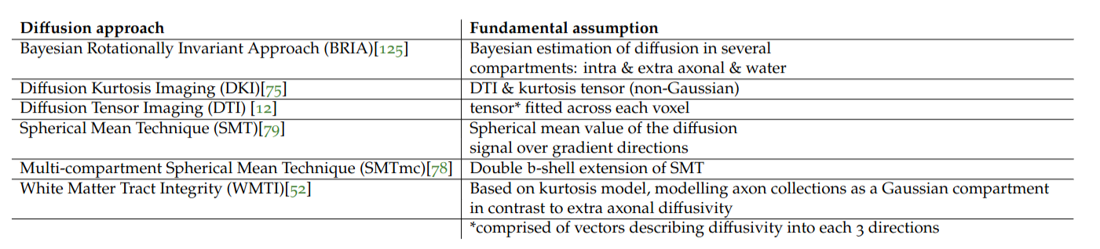
Concepts
Results
Conclusions
2. Diffusion MRI (biophy. models)
Signal representation models
Ignore underlying tissue & simply desc. signal (DTI, DKI)
Tissue models
Assumptions made about geometry (the others)
This is useful as there are major differences between white and grey matter and cerebrosp. fluid
Additional modelling opportunities of microstructure, intra- & extra-axonal space

Slide 12
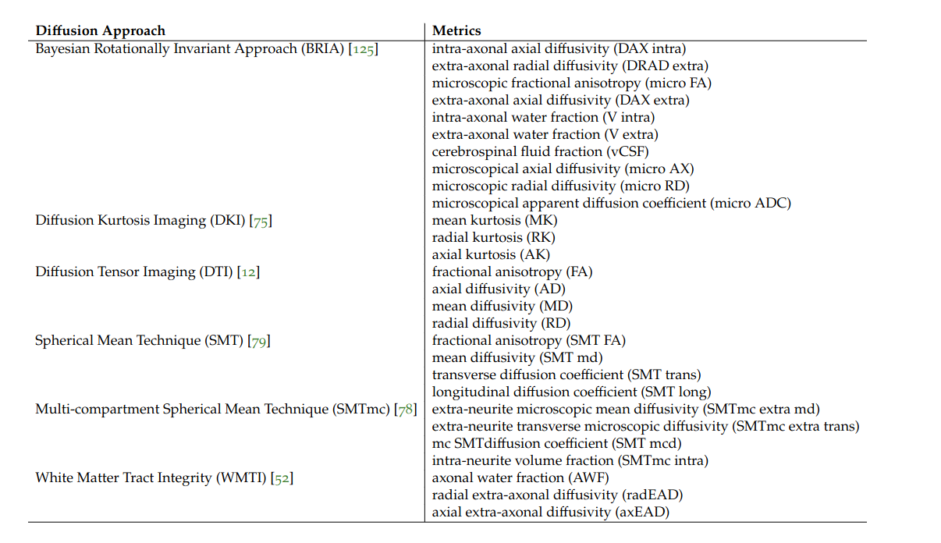
Concepts
Results
Conclusions
2. Diffusion MRI (biophy. models)
Now, let’s look at how we can combine the normative age-association idea (incl. brain age), and the metrics of different bio-physical models

Slide 13
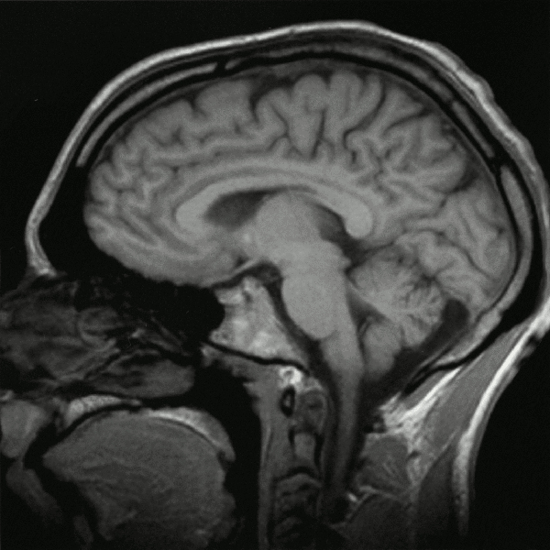
Concepts
Results
Conclusions
Secondary focus: T1w data
Secondary data source: sMRI
Two uses:
Minimally processed volumes
Thickness, volume, and surface area averages

Slide 14

Data & what’s been done with it?
Concepts
Results
Conclusions
UK Biobank ~ 50k cross-sec, 3k 2x scans
Brain age predictions
Laterality / asymmetry assessment
Ageing-related changes
Association testing w age & phenotypes

Slide 15
Densly sampled & validation data
Concepts
Results
Conclusions
Bergen Breakfast Scanning Club
Bergen Breakfast Scanning Club (N = 3, each > 25 scans, total = 110 scans)
Frequently Travelling Human Phantom (N = 1, > 550 scans)
Local Oslo data (cross-sectional)
TOP (N = 856)
Norwegian Cognitive Neuro Genetics sample (N = 209)

Slide 16
2. RESULTS

Slide 17
White matter ageing: study 1
Concepts
Results
Conclusions
Study | Main Outcomes
1) Brain‐wide associations between white matter and age highlight the role of fornix microstructure in brain ageing | 1) Validation of diffusion approaches with brain age (similar patterns) 2) Fornix and forceps minor (corpos colassum are strongly age sensitive)
2) Bio-psycho-social factors’ associations with brain age: a large-scale UK Biobank diffusion study of 35,749 participants | 1) Further validation of diffusion approaches (similar association patterns of brain ages) 2) Brain age appears as general indicator of health
3) Considerations on brain age predictions from repeatedly sampled data across time | 1) Pre-trained state-of-the-art brain age model not applicable in clinic (strong variability) 2) Field strength explains some of variability
4) Brain asymmetries from midlife to old adulthood and hemispheric brain age | 1) Asymmetries decrease in WM but increase in GM, fornix strongly asymmetric 2) Hemispheric brain age
5) Distinct longitudinal white matter changes and associated polygenic risk in the UK Biobank | 1) mapping of voxel-to-global white matter (WM) ageing (highlighting again fornix) 2) distributed genetic underpinnings of WM

Slide 18
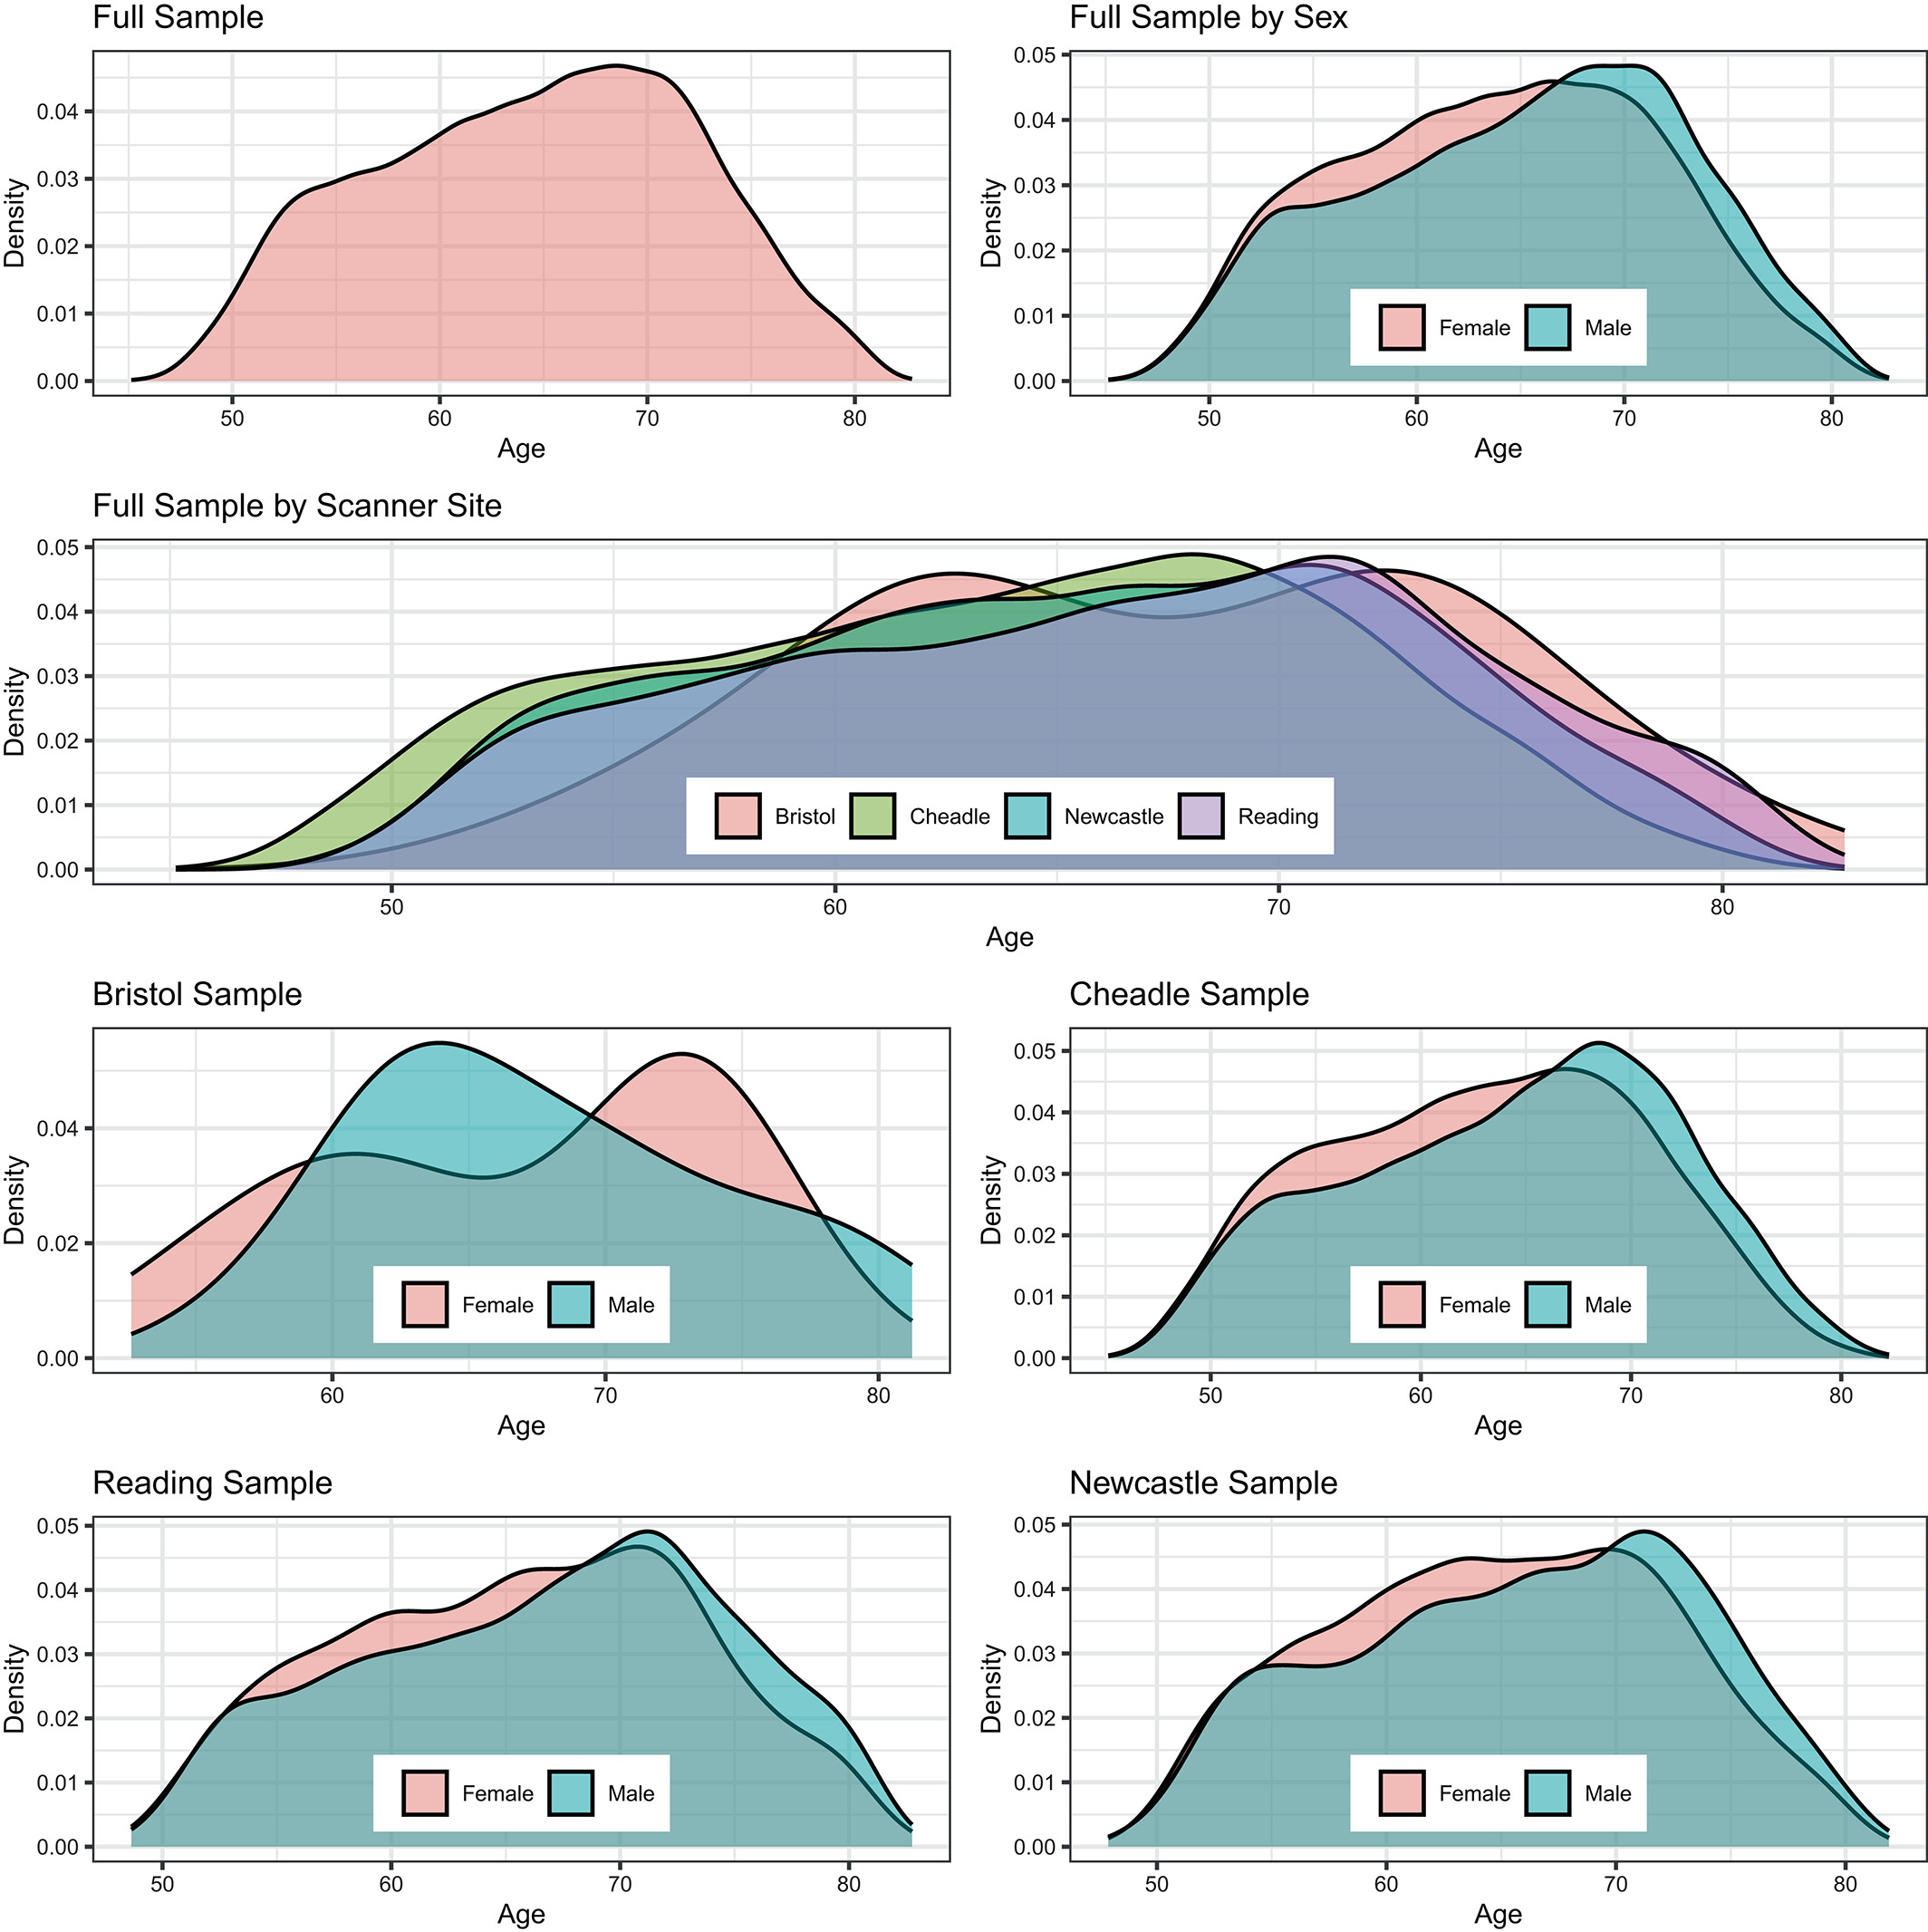
White matter ageing: study 1
Concepts
Results
Conclusions
After exclusions N = 35,749 UKB healthy adults
Multiple white matter microstructure metrics: DTI, DKI, BRIA, SMT & mcSMT, WMTI
1 Korbmacher et al., 2023, Hum. Brain Map. 44(10)

Slide 19
White matter ageing: study 1
Concepts
Results
Conclusions
Goals
Show WM-age associations
Identify most age-sensitive white matter regions
1 Korbmacher et al., 2023, Hum. Brain Map. 44(10)

Slide 20
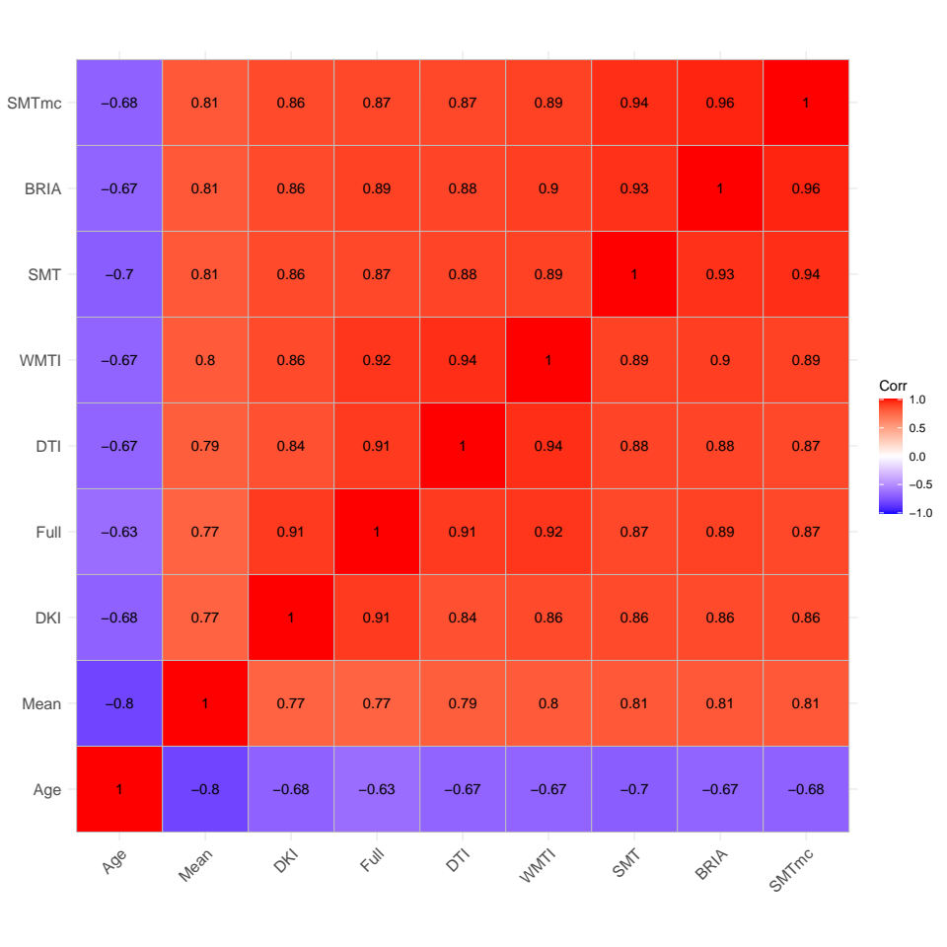
White matter ageing: study 1
Concepts
Results
Conclusions
Brain age estimates
XGB on tabular data
similar across diffusion approaches (DTI, DKI, …)¹
1 Korbmacher et al., 2023, Hum. Brain Map. 44(10)

Slide 21
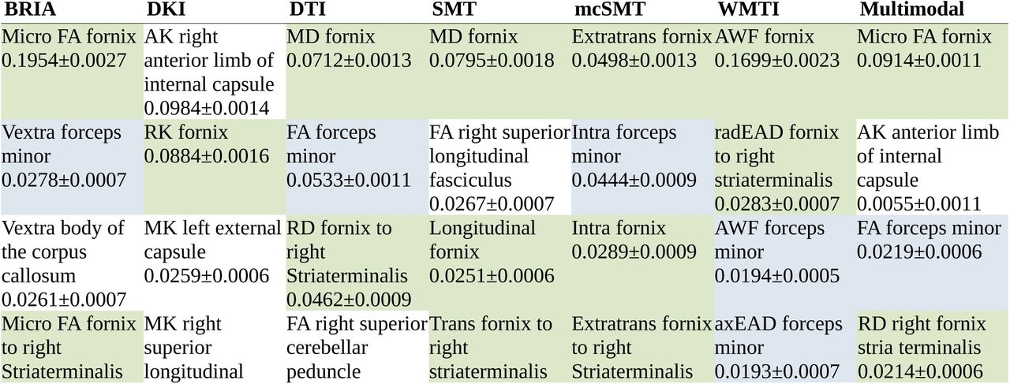
White matter ageing: study 1
Concepts
Results
Conclusions
Most important regions for brain age predictios:
fornix & forceps minor¹
1 Korbmacher et al., 2023, Hum. Brain Map. 44(10)

Slide 22
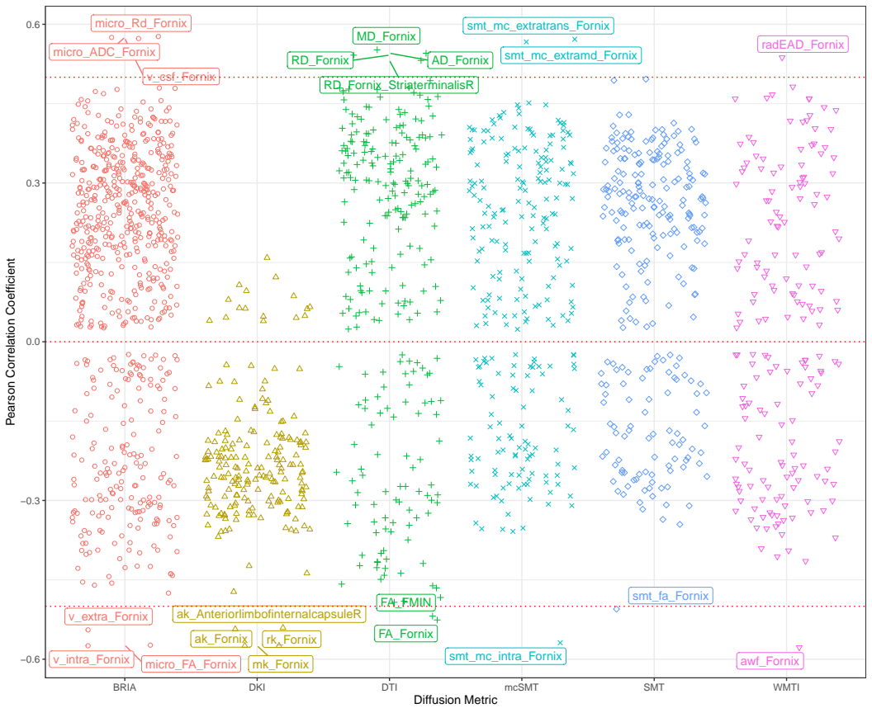
White matter ageing: study 1
Concepts
Results
Conclusions
Concurrent findings
Strong crude fornix WM microstr.-age relationships underline feature importance findings
1 Korbmacher et al., 2023, Hum. Brain Map. 44(10)

Slide 23
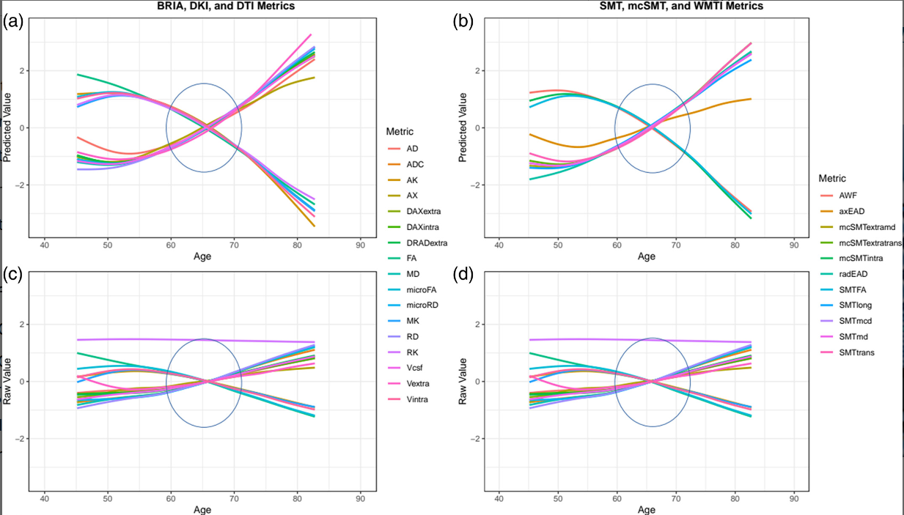
White matter ageing: study 1
Concepts
Results
Conclusions
Corrected (a-b) & uncorrected (c-d) WM microstructure-age relationships follow similar patterns across mapping approaches: diffusiv. & intra-axonal water fraction increases; FA, extra axonal water & kurtosis decrease
1 Korbmacher et al., 2023, Hum. Brain Map. 44(10)

Slide 24
White matter ageing: study 1
Concepts
Results
Conclusions
Meaning?
Diffusion approaches reflect similar biological concept
(Lower structural integraty at a higher age)
Fornix
Contributes most to explaining age, degenerates quicker than whole-brain averages
Increases in radial diffusivity measures from DKI and BRIA (DRADextra) higher plasticity?
Ageing biomarker? Deep brain stim target?

Slide 25
White matter ageing: study 2
Concepts
Results
Conclusions
Study | Main Outcomes
1) Brain‐wide associations between white matter and age highlight the role of fornix microstructure in brain ageing | 1) Validation of diffusion approaches with brain age (similar patterns) 2) Fornix and forceps minor (corpos colassum are strongly age sensitive)
2) Bio-psycho-social factors’ associations with brain age: a large-scale UK Biobank diffusion study of 35,749 participants | 1) Further validation of diffusion approaches (similar association patterns of brain ages) 2) Brain age appears as general indicator of health
3) Considerations on brain age predictions from repeatedly sampled data across time | 1) Pre-trained state-of-the-art brain age model not applicable in clinic (strong variability) 2) Field strength explains some of variability
4) Brain asymmetries from midlife to old adulthood and hemispheric brain age | 1) Asymmetries decrease in WM but increase in GM, fornix strongly asymmetric 2) Hemispheric brain age
5) Distinct longitudinal white matter changes and associated polygenic risk in the UK Biobank | 1) mapping of voxel-to-global white matter (WM) ageing (highlighting again fornix) 2) distributed genetic underpinnings of WM

Slide 26
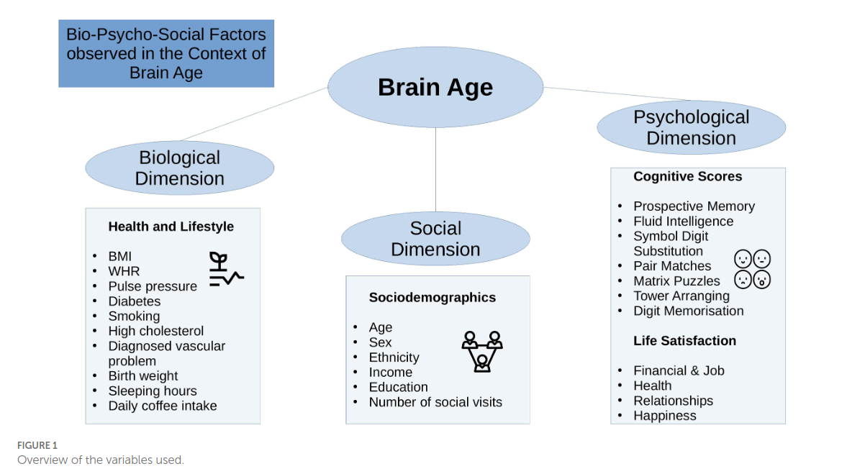
White matter ageing: study 2
Concepts
Results
Conclusions
Goal: Associating brain ages from study 1¹ with bio-psycho-social (BPS) factors²
1 Korbmacher et al., 2023, Hum. Brain Map.; 2 Korbmacher et al., 2023, Front. Psy. 14:1117732

Slide 27
White matter ageing: study 2
Concepts
Results
Conclusions
Outcomes: Significant effects: Waist-to-hip ratio, diabetes, hypertension, smoking, matrix puzzles solving, job- & health satisfaction and perception
Conclusion: WM brain age reflects overall health but is not well-predicted by any of the observed (BPS) domains

Slide 28
White matter ageing: study 5
Concepts
Results
Conclusions
Study | Main Outcomes
1) Brain‐wide associations between white matter and age highlight the role of fornix microstructure in brain ageing | 1) Validation of diffusion approaches with brain age (similar patterns) 2) Fornix and forceps minor (corpos colassum are strongly age sensitive)
2) Bio-psycho-social factors’ associations with brain age: a large-scale UK Biobank diffusion study of 35,749 participants | 1) Further validation of diffusion approaches (similar association patterns of brain ages) 2) Brain age appears as general indicator of health
3) Considerations on brain age predictions from repeatedly sampled data across time | 1) Pre-trained state-of-the-art brain age model not applicable in clinic (strong variability) 2) Field strength explains some of variability
4) Brain asymmetries from midlife to old adulthood and hemispheric brain age | 1) Asymmetries decrease in WM but increase in GM, fornix strongly asymmetric 2) Hemispheric brain age
5) Distinct longitudinal white matter changes and associated polygenic risk in the UK Biobank | 1) mapping of voxel-to-global white matter (WM) ageing (highlighting again fornix) 2) distributed genetic underpinnings of WM

Slide 29
White matter ageing: study 5
Concepts
Results
Conclusions
Goal: mapping longitudinal white matter changes & their polygentic risk architecture
Polygenic risk = individual’s genetic propensity for a trait by aggregating the estimated effects of risk variants across the entire genome
ASD, MDD, SCZ, ADHD, BIP, OCD, ANX, AD
Preprint: https://doi.org/10.1101/2023.10.19.23297257

Slide 30
White matter ageing: study 5
Concepts
Results
Conclusions
Data & Analysis
Longitudinal white matter assessments in the UKB (N=2,944, two scans with ca 2½ years in between)
Different levels of analysis: global, regional, voxel
Preprint under preparation

Slide 31
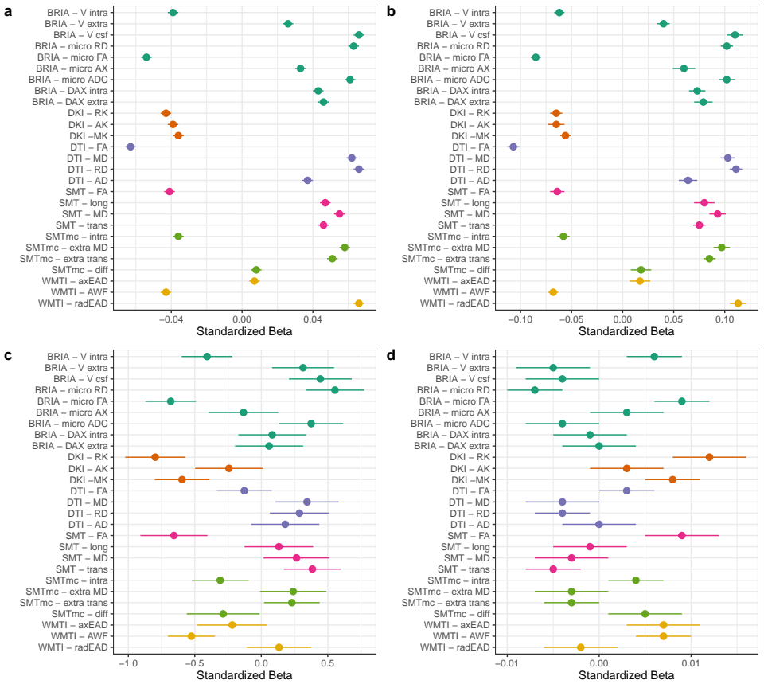
White matter ageing: study 5
Concepts
Results
Conclusions
Summary of adjusted global average findings
FA & intra-axonal water fraction decrease
Diffusivity (axial, mean radial) & extra-axonal water fraction increase
Kurtosis metrics decrease
Panels: fixed effects of a) age, b) time point, c) sex, d) sex:age
Preprint under preparation

Slide 32
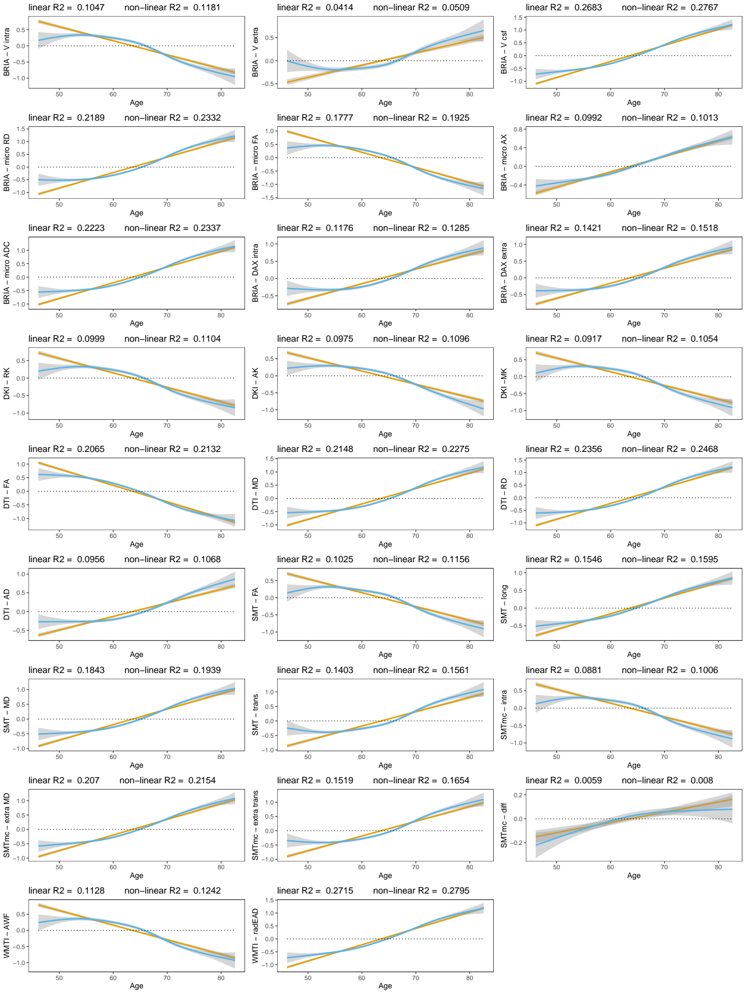
White matter ageing: study 5
Concepts
Results
Conclusions
Summary of adjusted global average age associations of WM
Repl. cross-sec. findings:

Slide 33
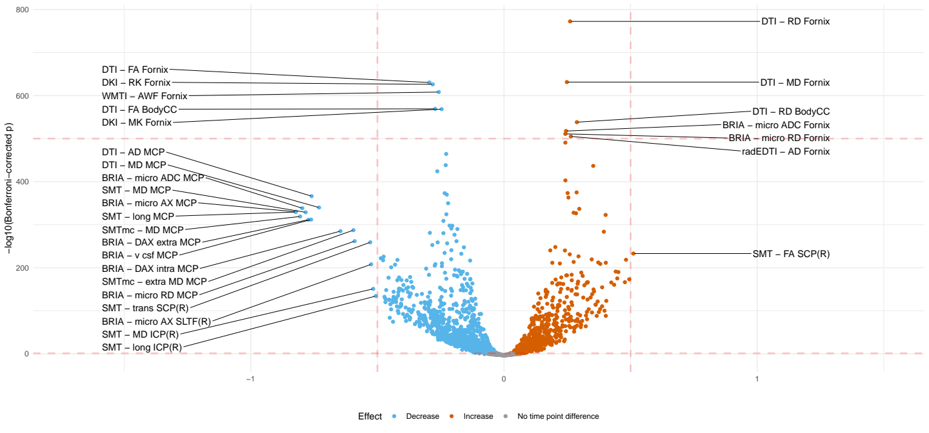
White matter ageing: study 5
Concepts
Results
Conclusions
Summary of unadjusted region average findings
Very similar trends to global findings in terms of metrics, but identification of regions (peduncle&fornix)
Crude age-white matter associations
CC=corpus callosum, M/I/SCP=medial/inferior/superior cerebral peduncle, SLTF=superior longitudinal temporal fasciculus

Slide 34
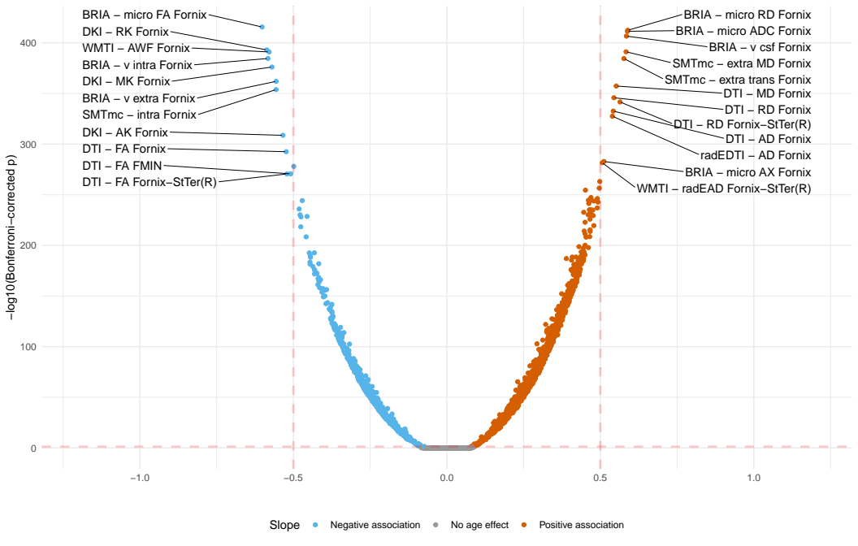
White matter ageing: study 5
Concepts
Results
Conclusions
Summary of adjusted region average findings
Very similar trends to global findings in terms of metrics, but identification of regions (fornix)
Adjusted age-white matter relationships, StTer = stria terminalis

Slide 35
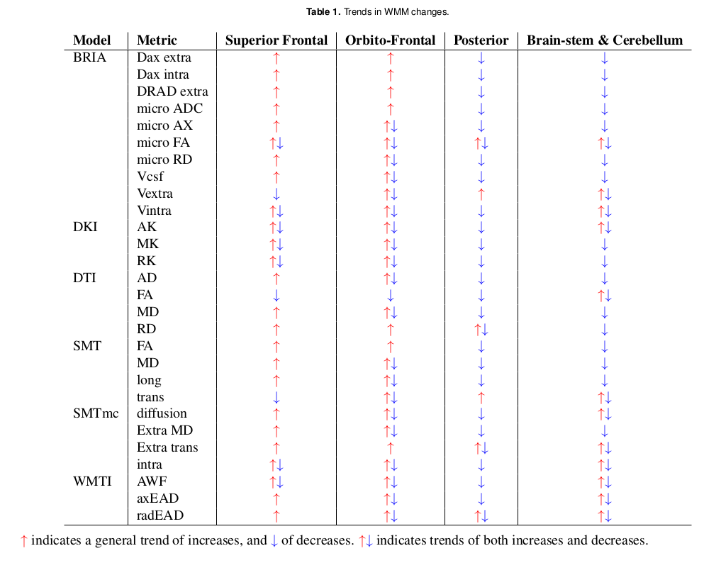
White matter ageing: study 5
Concepts
Results
Conclusions
Summary of voxel-level findings
Global FA decrease (de-myelination?)
Sup.frontal diffusivity increase, otherwise decrease

Slide 36
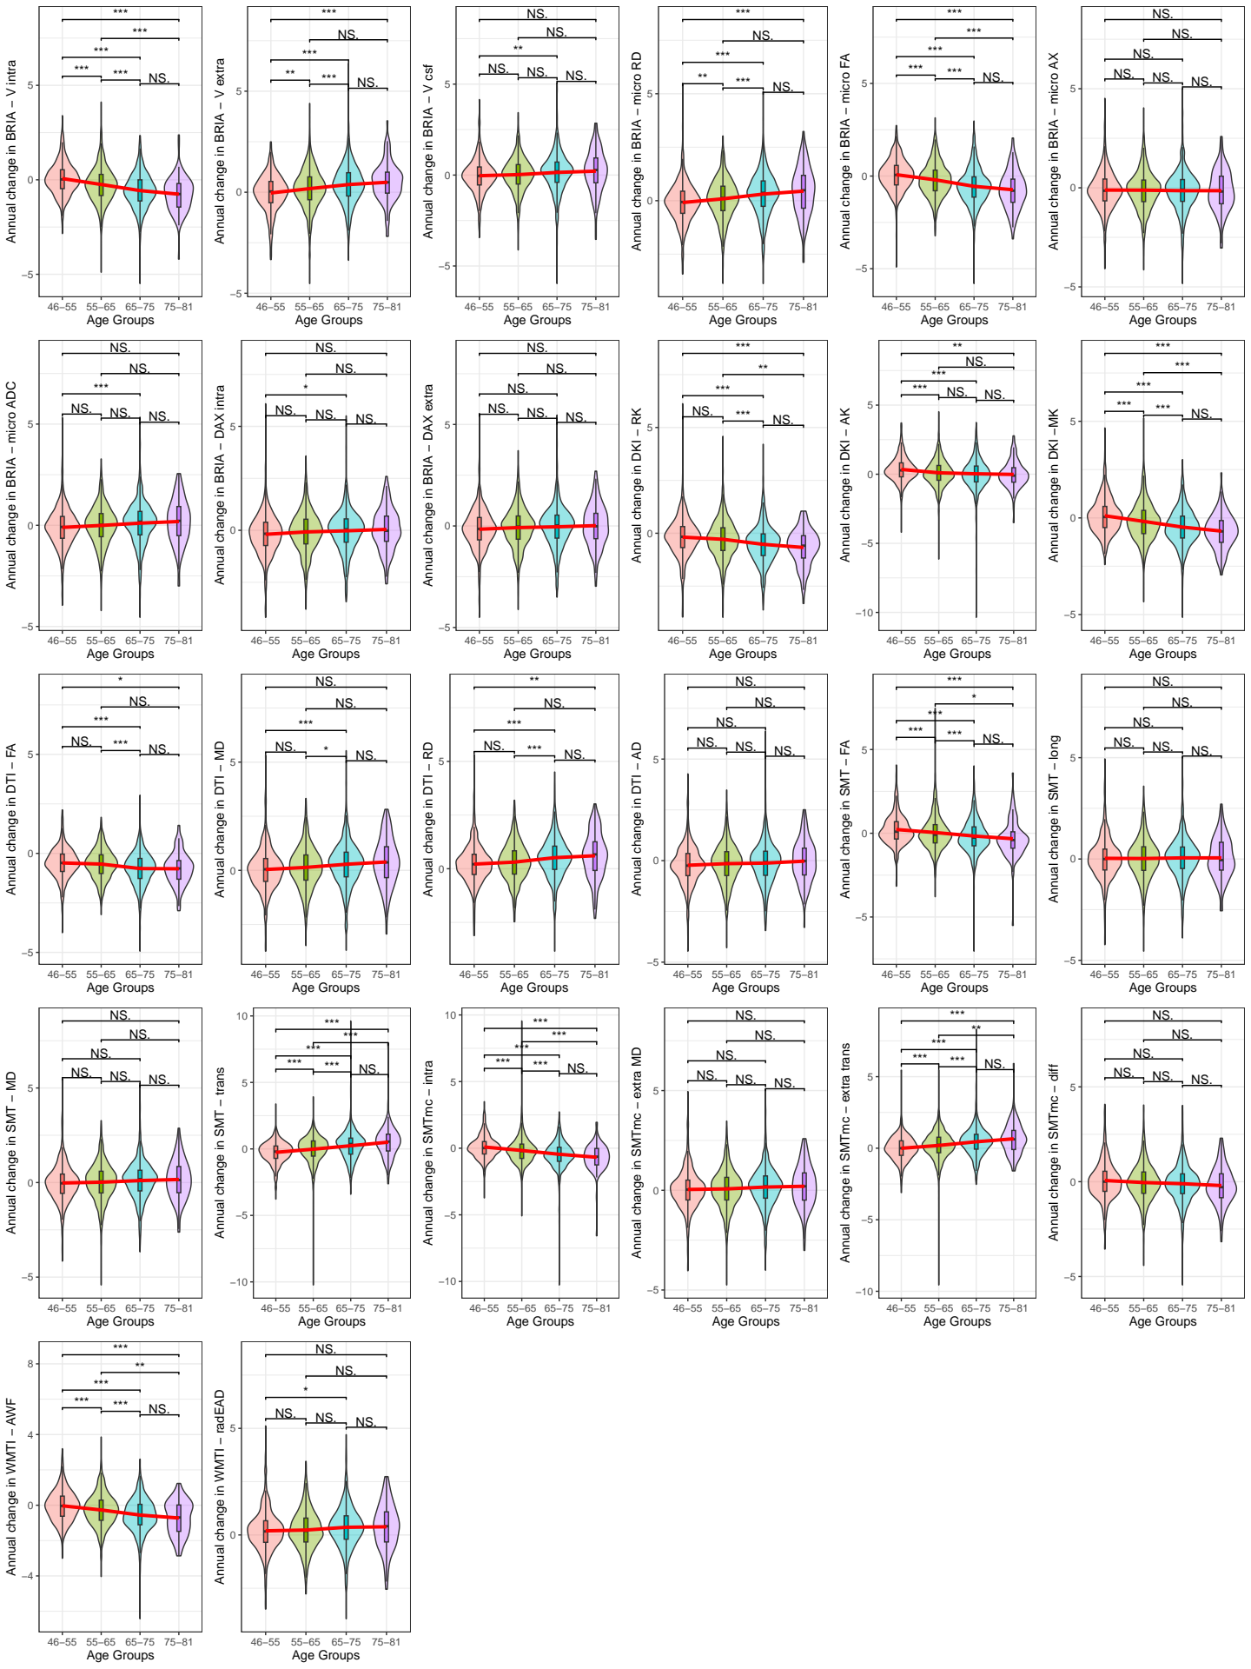
White matter ageing: study 5
Concepts
Results
Conclusions
Age-relationship of the annual rate of change (ARoC) of global WM metrics:
ARoC higher at higher ages for most metrics.

Slide 37
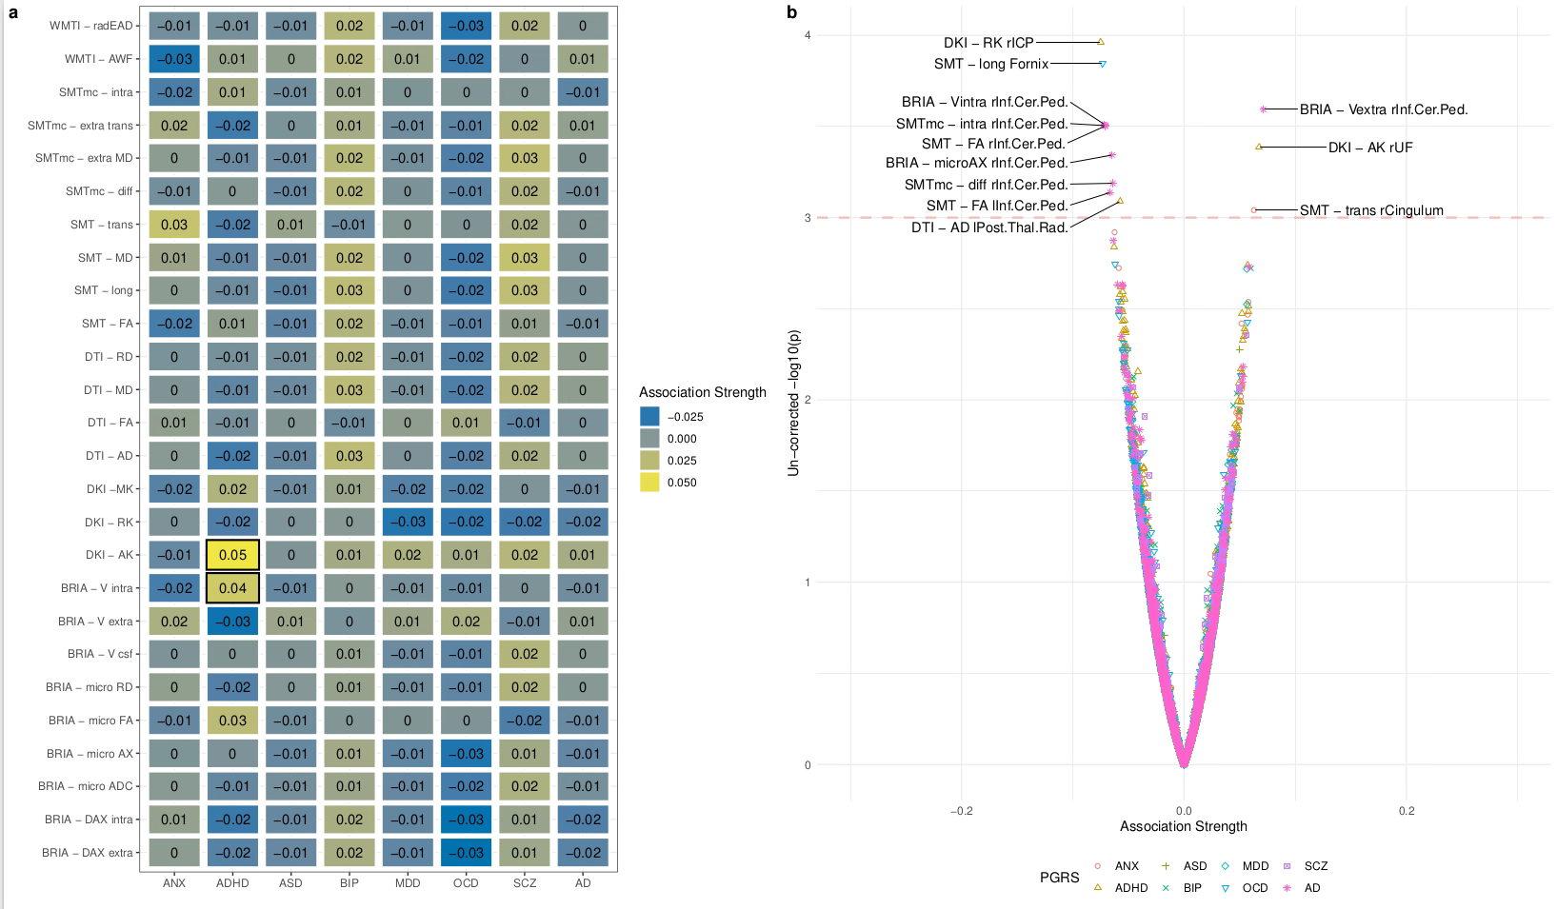
White matter ageing: study 5
Concepts
Results
Conclusions
Gene-relationship of annual rate of change (ARoC) with global WM metrics: non-sign. after mult. comp. (small effects)

Slide 38
White matter ageing: study 5
Concepts
Results
Conclusions
Outcomes: Again, central brain regions are most age sensitive (fornix, cerebral peduncle). Cerebral peduncle strongest related to PGRS, particularly Alzheimer’s.
Conclusion: Central, ventricle-near brain areas might be ageing biomarkers

Slide 39
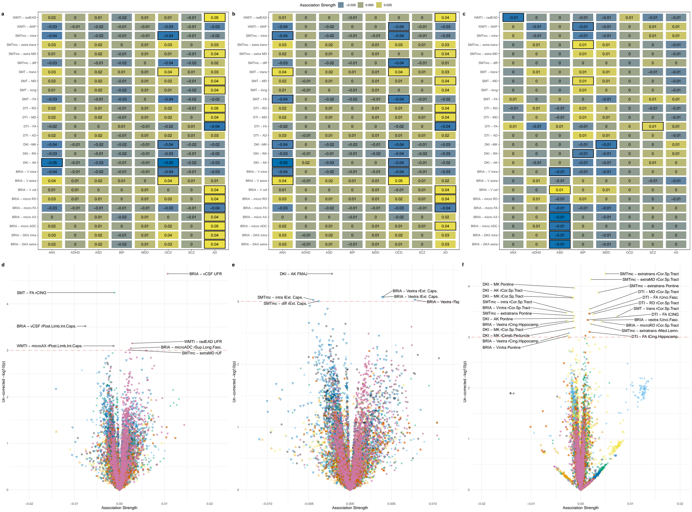
White matter ageing: study 5
Concepts
Results
Conclusions
Cross-sectionalgene-relation-ship with global WM metrics
Non-sign. after mult. comparis. (due to small effects)

Slide 40
Putting brain age to the test
Concepts
Results
Conclusions
Study | Main Outcomes
1) Brain‐wide associations between white matter and age highlight the role of fornix microstructure in brain ageing | 1) Validation of diffusion approaches with brain age (similar patterns) 2) Fornix and forceps minor (corpos colassum are strongly age sensitive)
2) Bio-psycho-social factors’ associations with brain age: a large-scale UK Biobank diffusion study of 35,749 participants | 1) Further validation of diffusion approaches (similar association patterns of brain ages) 2) Brain age appears as general indicator of health
3) Considerations on brain age predictions from repeatedly sampled data across time | 1) Pre-trained state-of-the-art brain age model not applicable in clinic (strong variability) 2) Field strength explains some of variability
4) Brain asymmetries from midlife to old adulthood and hemispheric brain age | 1) Asymmetries decrease in WM but increase in GM, fornix strongly asymmetric 2) Hemispheric brain age
5) Distinct longitudinal white matter changes and associated polygenic risk in the UK Biobank | 1) mapping of voxel-to-global white matter (WM) ageing (highlighting again fornix) 2) distributed genetic underpinnings of WM

Slide 41
Putting brain age to the test: study 3
Concepts
Results
Conclusions
Goal: Identify longitudinal stability of brain age
Why? Assessing clinical utility of brain age
How? Estimating brain age for multiple time points for the same individuals using a pre-trained deep convolutional neural network (pyment) on T1w minimally processed data
Korbmacher et al., 2023, Brain & Beh. (in press)

Slide 42
Putting brain age to the test: study 3
Concepts
Results
Conclusions
Densely sampled data
Bergen Breakfast Scanning Club (N = 3, each > 25 scans, total = 110 scans)
Frequently Travelling Human Phantom (N = 1, > 550 scans)
Local Oslo data (cross-sectional)
TOP (N = 856)
Norwegian Cognitive Neuro Genetics sample (N = 209)
Korbmacher et al., 2023, Brain & Beh. (in press)

Slide 43
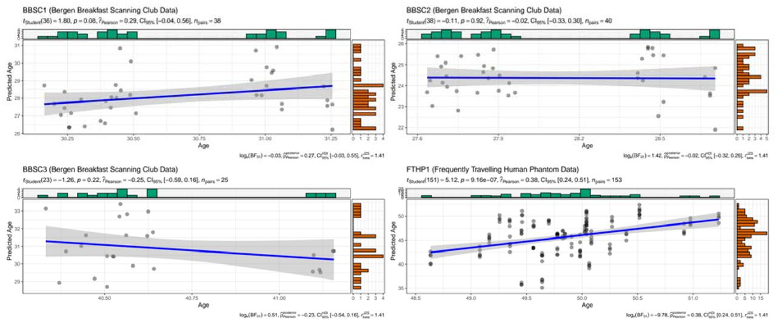
Putting brain age to the test: study 3
Concepts
Results
Conclusions
Result: Label-prediction correspondance was not too great
Interpretation: Too short inter-scan interval?
Korbmacher et al., 2023, Brain & Beh. (in press)

Slide 44
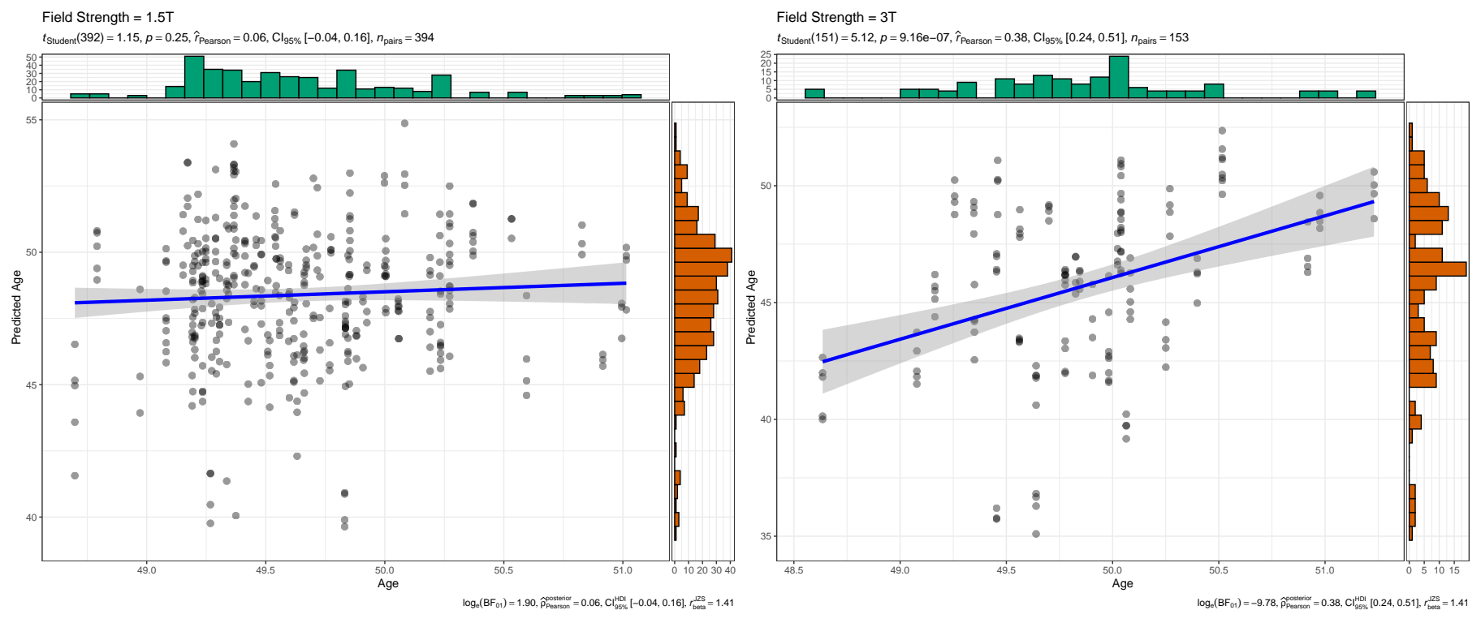
Putting brain age to the test: study 3
Concepts
Results
Conclusions
Follow-up: Testing two potential reasons for low corrspondence
Scan quality (diffuse results)
Field strength (bingo! but data only avail. for one sub.)
Hence, replicated in cross-sectional data
Korbmacher et al., 2023, Brain & Beh. (in press)

Slide 45
Putting brain age to the test: study 3
Concepts
Results
Conclusions
Conclusions & Interpretation
Brain age systematically underestimated for healthy controls at 3T & higher prediction error than at 1.5T
Underestimations can be larger(!) than what the model error would suggest when trained on cross-sec data
Field strength matters for brain age estimates!
Ergo: there is still a lot to improve when tansitioning brain age into a clinical marker
Perhaps multiple brain age models for different groups?
Korbmacher et al., 2023, Brain & Beh. (in press)

Slide 46
Brain asymmetry & hemispheric brain age: study 4
Concepts
Results
Conclusions
Study | Main Outcomes
1) Brain‐wide associations between white matter and age highlight the role of fornix microstructure in brain ageing | 1) Validation of diffusion approaches with brain age (similar patterns) 2) Fornix and forceps minor (corpos colassum are strongly age sensitive)
2) Bio-psycho-social factors’ associations with brain age: a large-scale UK Biobank diffusion study of 35,749 participants | 1) Further validation of diffusion approaches (similar association patterns of brain ages) 2) Brain age appears as general indicator of health
3) Considerations on brain age predictions from repeatedly sampled data across time | 1) Pre-trained state-of-the-art brain age model not applicable in clinic (strong variability) 2) Field strength explains some of variability
4) Brain asymmetries from midlife to old adulthood and hemispheric brain age | 1) Asymmetries decrease in WM but increase in GM, fornix strongly asymmetric 2) Hemispheric brain age
5) Distinct longitudinal white matter changes and associated polygenic risk in the UK Biobank | 1) mapping of voxel-to-global white matter (WM) ageing (highlighting again fornix) 2) distributed genetic underpinnings of WM

Slide 47
Brain asymmetry & hemispheric brain age: study 4
Concepts
Results
Conclusions
Background: Previous studies suggest relationships between brain asymmetry and different disorders
Particularly, decreasing asymmetry observed in healthy GM ageing, which is accelerated in AD¹
Subsequent questions: Generalizable to different GM & WM metrics? And can we learn more about brain age through these observations?
Goal: Mapping brain asymmetries throughout midlife & older ages
1 Roe et al., 2021, Nat. Comm. 12, 71.

Slide 48
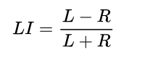
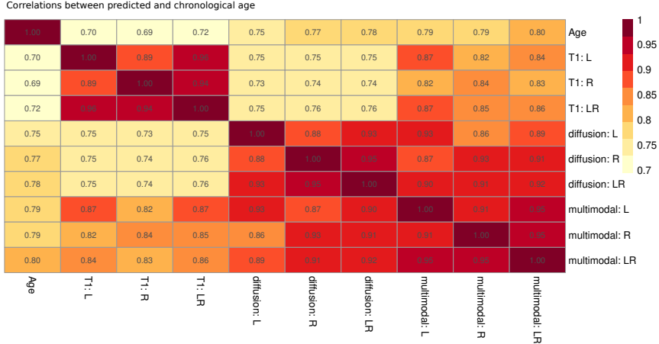
Brain asymmetry & hemispheric brain age: study 4
Concepts
Results
Conclusions
T1w (N = 48,040) & dMRI (N = 39,637) features, overlap/ multimodal N = 39, 507
Asymmetry calculated by laterality index (LI)
Hemispheric brain age (HBA) calculated on L/R features
HBA & brain ages correspond closely within modalities
No sign BA differences for modality, hemisphere, handedness considering both sexes together
Preprint v2:
https://doi.org/10.1101/2023.08.21.554103

Slide 49
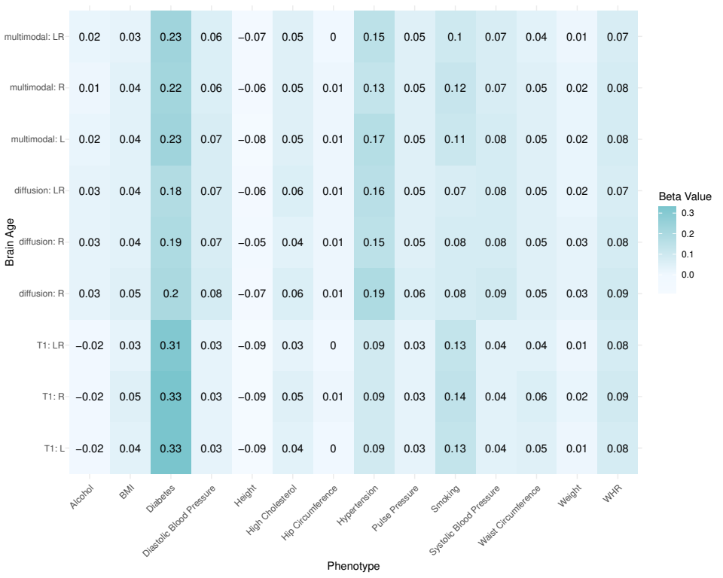
Brain asymmetry & hemispheric brain age: study 4
Concepts
Results
Conclusions
Result: Brain ages of the same modality relate similarly to different phenotypes
Fig.: Association between general health and lifestyle phenotypes and BA estimated from different modalities, left, right and both hemispheres. For simplicity, standardized
slopes with |β| < 0.005 were rounded down to β = 0. L: left hemisphere, R: right hemisphere, LR: both hemispheres. Note that differences between participants who drink
alcohol compared to those who do not drink alcohol were non-significant, and hip circumference was only significantly associated with dMRI-derived BAs

Slide 50
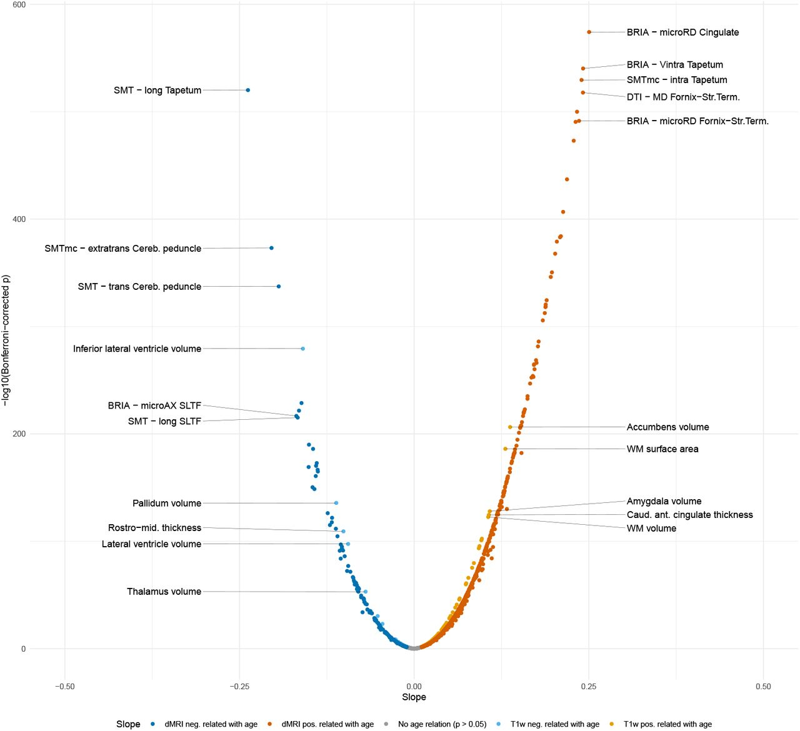
Brain asymmetry & hemispheric brain age: study 4
Concepts
Results
Conclusions
Results
While L/R ageing trends are similar, brain age & feature asymmetry (LI) are age-dependent
WM asymmetries are more age-sensitive than GM asymmetries
Brain asymmetries are higher at higher ages, contrasting brain age asymmetries (lower)

Slide 51
3. CONCLUSIONS

Slide 52
Summary
Concepts
Results
Conclusions
Brain age is a general indicator of health; can be conceptualised in different ways
However, clinical implication of brain age requires still further work
We find deep regions [corpus callosum, cerebellum, limbic system (+ ventricles)] to be highly age-sensitive regions
Distributed spatial pattern of polygenic risk across WM

Slide 53
Way forward
Concepts
Results
Conclusions
Longitudinal change in WM brain age
Intra-individual “biomarkers”
Linking brain metrics’ age associations and brain ageing with phenotypes (structural equation modelling)

Slide 54









Ivan I. Maximov
Lars T. Westlye
Eli N. Eikefjord
Arvid Lundervold
Thank you!
Dennis van der Meer
Ann Marie de Lange
Dani Beck
Ole A. Andreassen
Tiril Gurholt

Slide 55
Questions?
How to contact me:
Email: Max.Korbmacher@hvl.no
Twitter: @KorbmacherMax

